Slide 2
Contents
Project objectives
Overview
Design proposals
Mechanical design
Electrical design
Programming
Results
Conclusion
Notes:
Designing process

Slide 3
1. Project objectives
Quadruped robot
Quadruped robot is a type of mobile robot that uses 4 legs to move around in the environment.
Why is quadruped robot important?
Over 50% of lands in the world is not viable for being covered by conventional vehicles [1].
Military, inspection and research applications.
Objectives of this project
Design and build a quadruped robot for research purpose that is affordable for students.
Notes:
Trend in research and product market. High quality robots are robust but expensive, while low-cost models lack in form and function

Slide 4
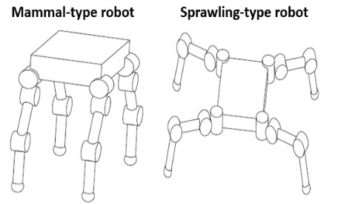
2. Overview
2.1 Types of quadruped robot
- Based on its configuration, there are Sprawling and Mammal type robot.
Figure 2.1 Sprawling and Mammal type quadruped robot principle diagram.
- Mammal type robots have faster walking speed, lower driving torque, and smaller footprint [2].

Slide 5
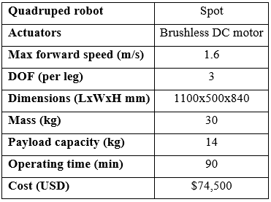
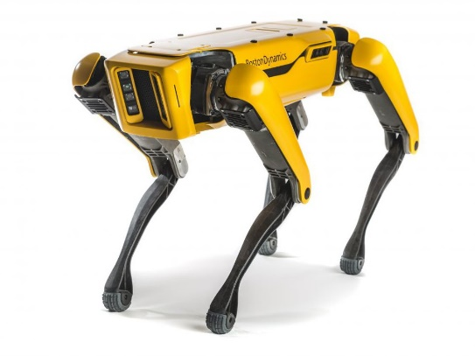
2. Overview
2.2 Available quadruped robot designs
- Spot by Boston Dynamics
Figure 2.2 Spot quadruped robot and its leg principle diagram.
Notes:
Complex but efficient leg config, but high cost

Slide 6
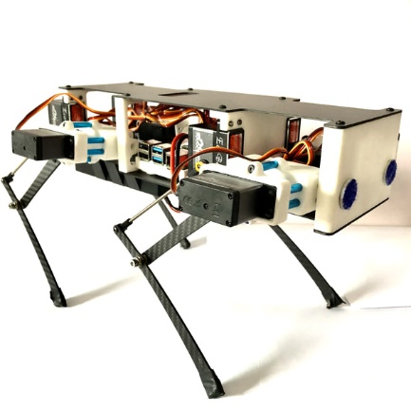
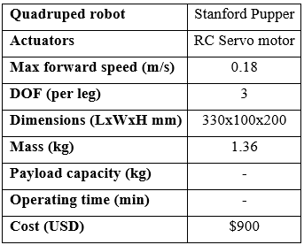
2. Overview
2.2 Available quadruped robot designs
- Stanford Pupper by Nathan Kau
Figure 2.3 Stanford Pupper quadruped robot and its leg principle diagram.
Notes:
Used at Stanford for student course

Slide 7
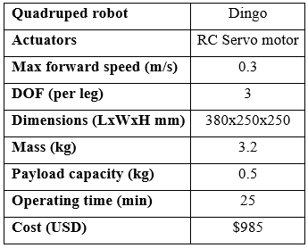
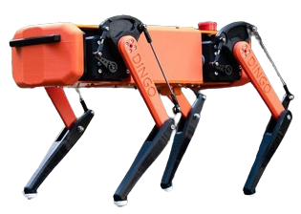
2. Overview
2.2 Available quadruped robot designs
- Dingo by Monash University
Figure 2.4 Dingo quadruped robot and its leg principle diagram.
Notes:
Student project, unique leg config -> reduce torque on hip motor

Slide 8
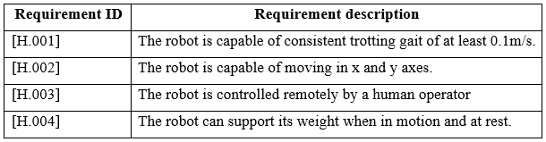
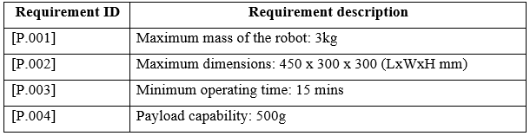

2. Overview
2.3 Design specifications
- High level requirements:
- Physical requirements:
- Financial requirements:
Notes:
Main reqs

Slide 9
3. Design proposals
3.1 Mechanical design proposal summary
Figure 3.1 Mechanical configuration of a single leg (left) and whole body (right).
Notes:
6 bar similar to Dingo, and 12DOF body

Slide 10
3. Design proposals
3.2 Electrical design proposal summary
Figure 3.2 Electrical diagram of the robot.
Notes:
Overall layout of electrical system

Slide 11
3. Design proposals
3.3 Programming proposal summary
Figure 3.3 Operating diagram of the robot.
Notes:
Trotting gait

Slide 12
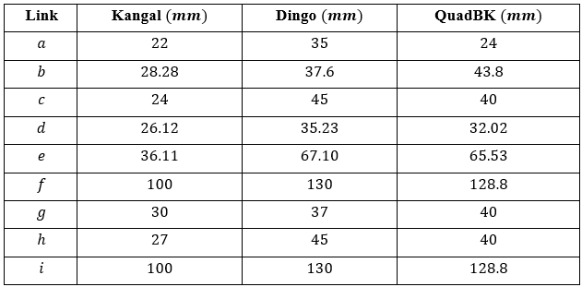
4. Mechanical design
4.1 Initial leg and body calculations
Figure 4.1 Leg diagram for design length parameters.

Slide 13
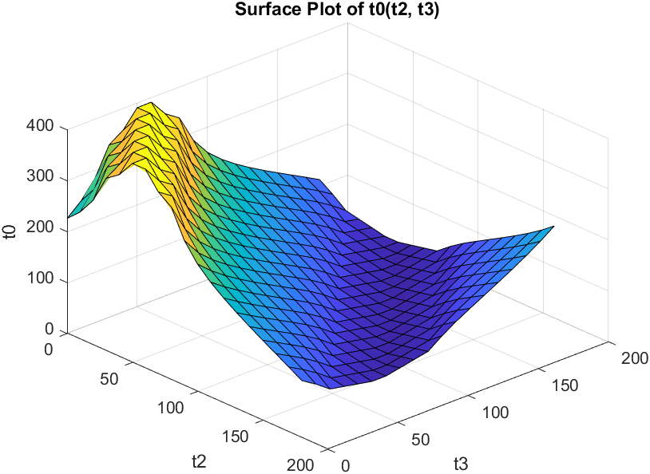
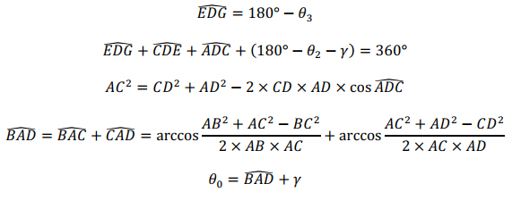

4. Mechanical design
4.1 Initial leg and body calculations
- Relationship between $θ_{0}$ and $θ_{3}$:

Slide 14
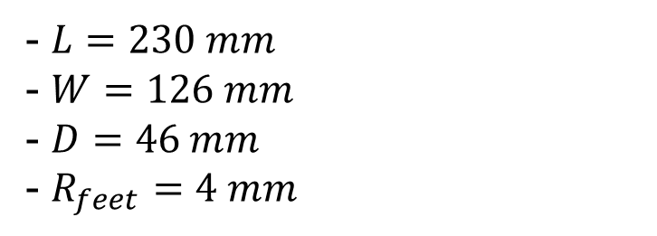
4. Mechanical design
4.1 Initial leg and body calculations
- $L=230 mm$
- $W=126 mm$
- $D=46 mm$
- $R_{feet}=4 mm$
Figure 4.2 Body diagram for design length parameters.
Notes:
Body dims for later calc

Slide 15
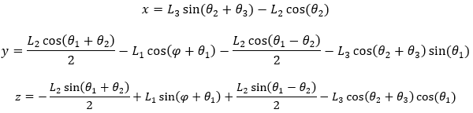
4. Mechanical design
4.2 Forward kinematics analysis
Denavit-Hartenberg method is used:
Notes:
X,y,z based on theta1,2,3

Slide 16
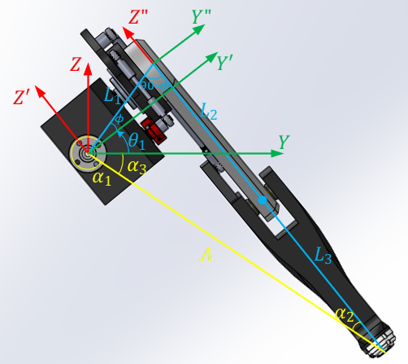
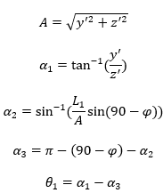
4. Mechanical design
4.3 Inverse kinematics analysis
Trigonometric method is used for initial 3D design. Calculate $θ_{1}$:
Figure 4.3 Leg diagram to solve the inverse kinematics for $θ_{1}$

Slide 17
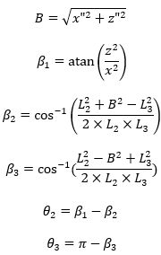
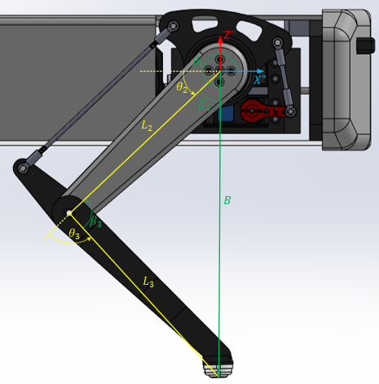

4. Mechanical design
4.3 Inverse kinematics analysis
Calculate $θ_{2}$ and $θ_{3}$:
Figure 4.4 Leg diagram to solve the inverse kinematics for $θ_{2}$ and $θ_{3}$

Slide 18
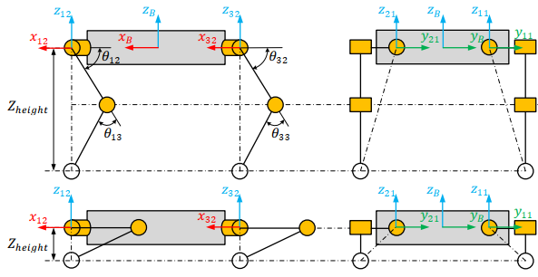
4. Mechanical design
4.4 Servo motor selection
Figure 4.5 The robot at 2 different heights, where the position of each feet remains the same

Slide 19
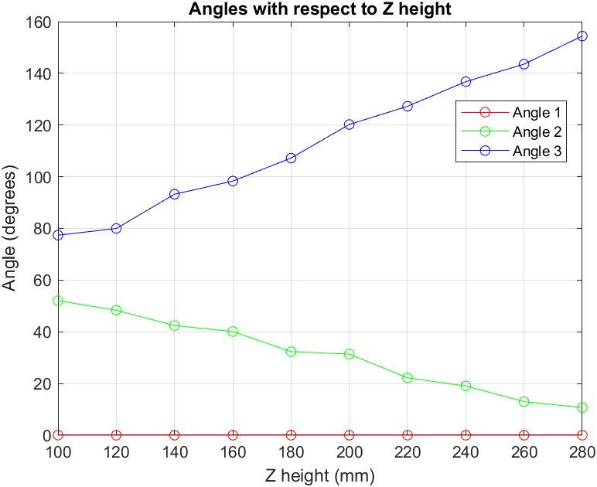
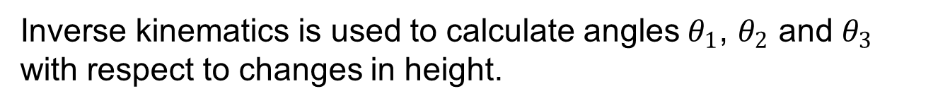
4. Mechanical design
4.4 Servo motor selection
Inverse kinematics is used to calculate angles $θ_{1}$, $θ_{2}$ and $θ_{3}$ with respect to changes in height.
Figure 4.6 Angles value at each joint with respect to $Z_{height}$

Slide 20
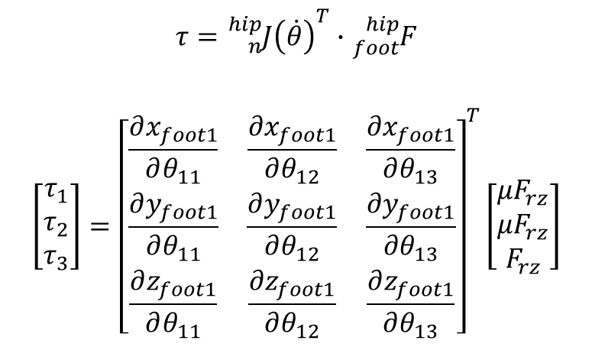
4. Mechanical design
4.4 Servo motor selection
A Jacobian matrix is derived from Forward kinematics functions.
Torque at each joint is calculated:
$$τ={{}_{n}^{hip}{J\left(\dot{θ}\right)}}^{T}∙{}_{foot}^{hip}F$$
$$\left[\begin{matrix}τ_{1} \\ τ_{2} \\ τ_{3}\end{matrix}\right]={\left[\begin{matrix}\frac{∂x_{foot1}}{∂θ_{11}} & \frac{∂x_{foot1}}{∂θ_{12}} & \frac{∂x_{foot1}}{∂θ_{13}} \\ \frac{∂y_{foot1}}{∂θ_{11}} & \frac{∂y_{foot1}}{∂θ_{12}} & \frac{∂y_{foot1}}{∂θ_{13}} \\ \frac{∂z_{foot1}}{∂θ_{11}} & \frac{∂z_{foot1}}{∂θ_{12}} & \frac{∂z_{foot1}}{∂θ_{13}}\end{matrix}\right]}^{T}\left[\begin{matrix}μF_{rz} \\ μF_{rz} \\ F_{rz}\end{matrix}\right]$$
Figure 4.7 External forces acting on the robot’s feet

Slide 21
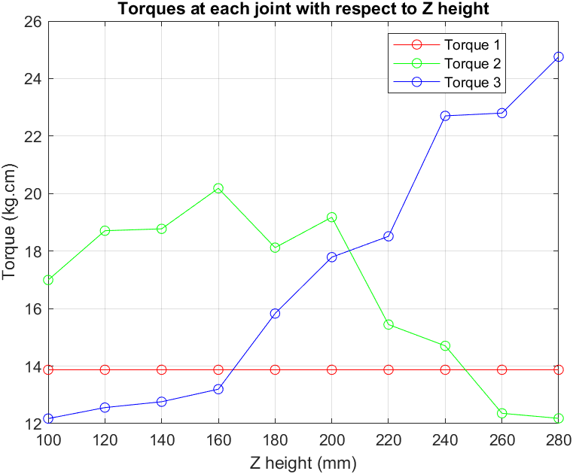
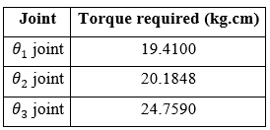
4. Mechanical design
4.4 Servo motor selection
- SPT5435LV 35kg.cm RC servo is chosen
Figure 4.8 Torques value at each joint with respect to $Z_{height}$

Slide 22
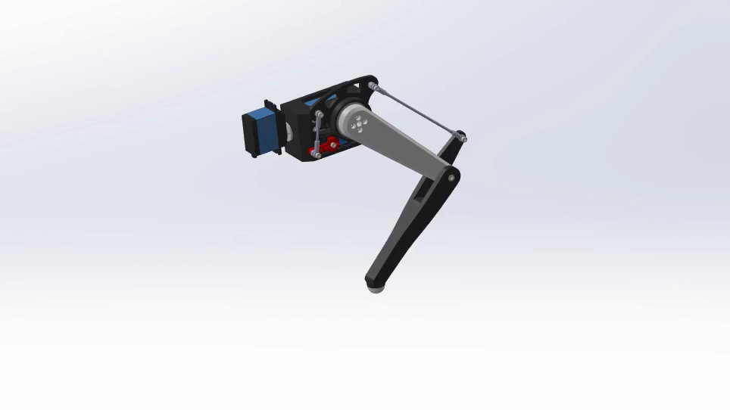
4. Mechanical design
4.5 Leg design assembly
Notes:
Leg is design based on chosen parameters, using 3d printed material and available parts

Slide 23
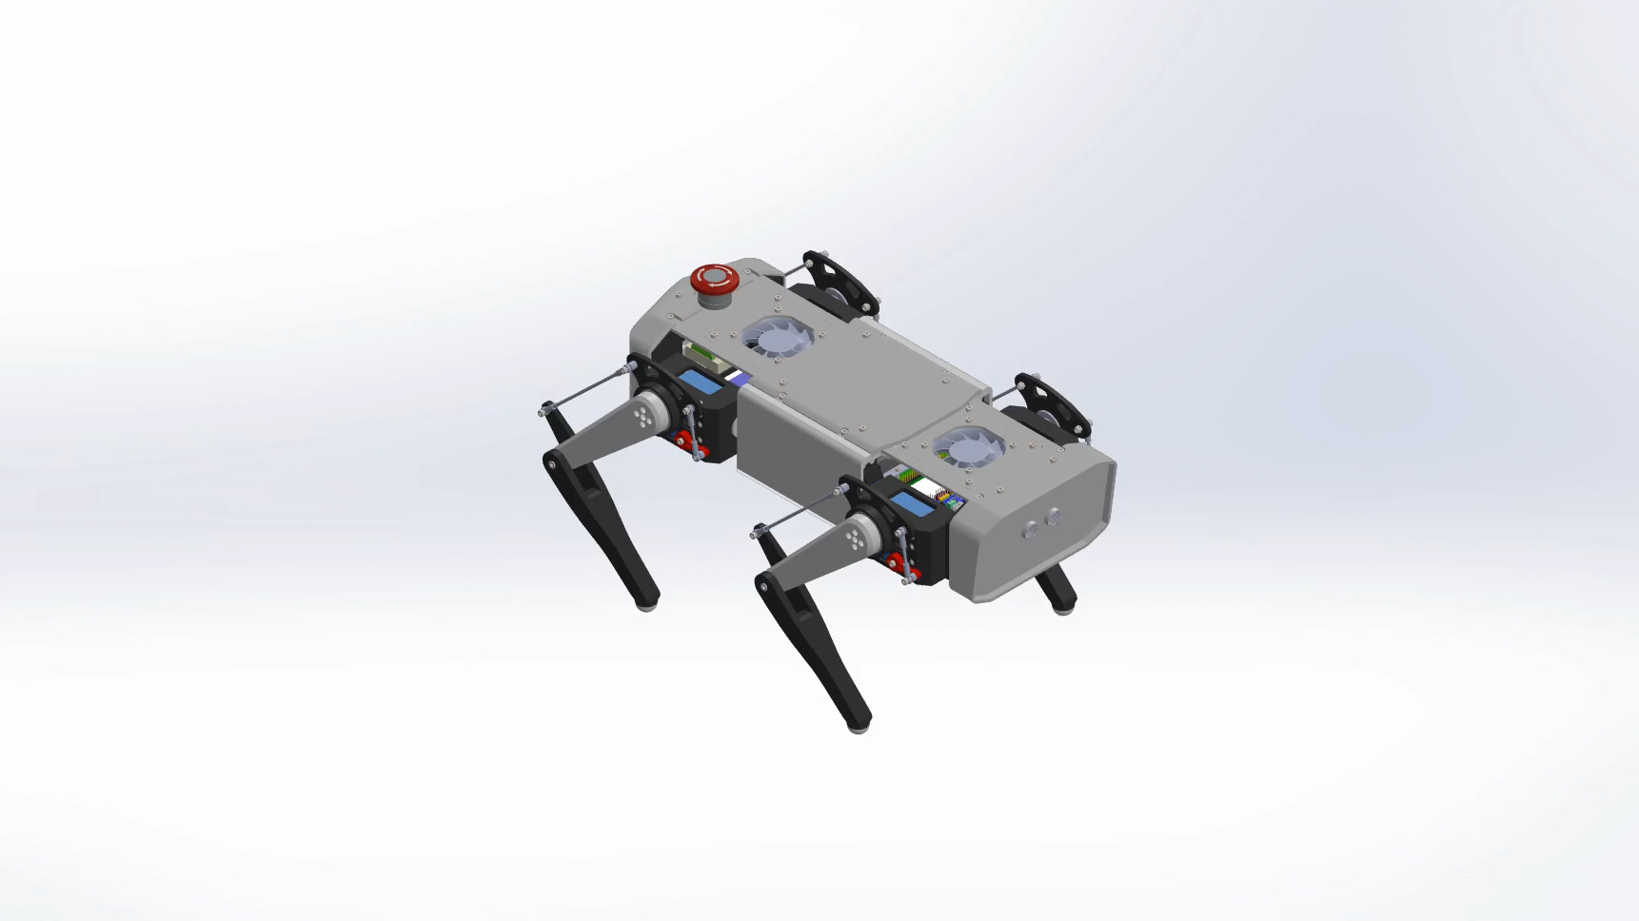
4. Mechanical design
4.6 Robot design assembly
Notes:
Modular design, each leg module is connected to the hip, hip connected to base

Slide 24
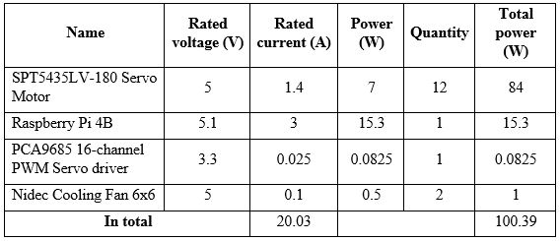
5. Electrical design
5.1 Battery selection
Summary of all components:

Slide 25
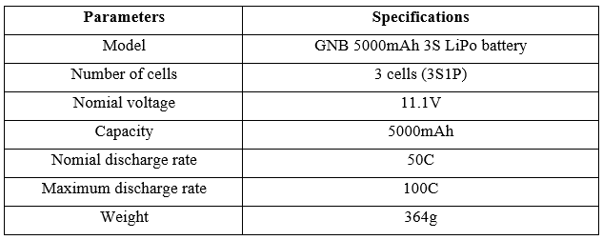
5. Electrical design
5.1 Battery selection
Chosen power supply battery:

Slide 26
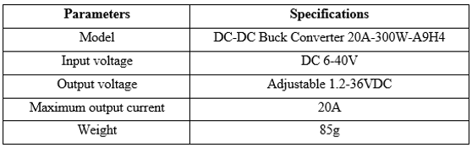
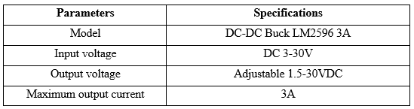
5. Electrical design
5.2 Converter selection
20A Converter for dynamic circuit:
Converter for control circuit and fans:

Slide 27
5. Electrical design
5.3 Electrical system summary
Figure 5.1 Power and communication diagram of the robot

Slide 28
6. Programming
6.1 Program summary
Control program is based on Stanford Pupper robot [3]
Figure 6.1 Flowchart diagram from controller input to actuation for a sample control.
Notes:
Adjust parameters in Controller. Add more functions to Hardware Interface.

Slide 29
6. Programming
6.2 Controller detail
The robot follows trotting pattern:
Figure 6.2 Diagram for trotting gait pattern of the robot
Notes:
Overlap time for stablisation

Slide 30
6. Programming
6.2 Controller detail
Controller responsible for gait scheduler:

Slide 31

6. Programming
6.3 Stance phase
In Stance phase, the legs touching ground push the body forward. Coordinates are updated in the x-axis as:
$$−v_{x}∙α∙dt_{stance}$$
Figure 6.3 The robot in stance phase of FR and BL legs

Slide 32
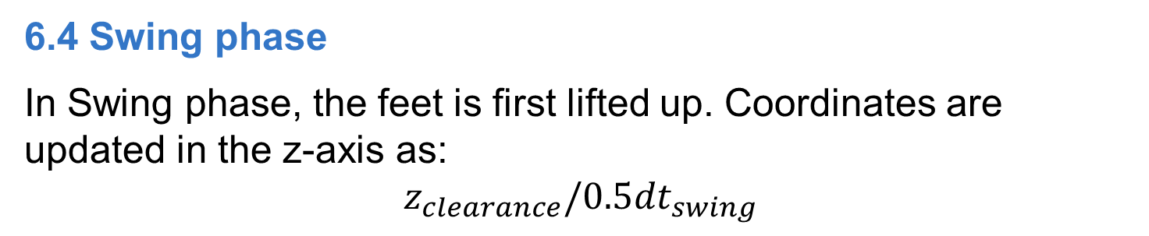
6. Programming
6.4 Swing phase
In Swing phase, the feet is first lifted up. Coordinates are updated in the z-axis as:
$$z_{clearance}/0.5dt_{swing}$$
Figure 6.4 The robot in swing phase of FL and BR legs

Slide 33
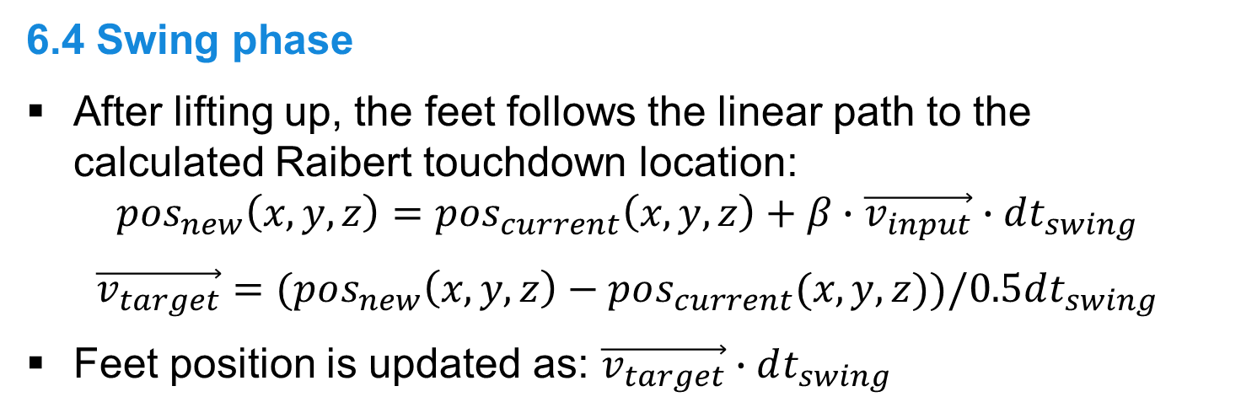
6. Programming
6.4 Swing phase
After lifting up, the feet follows the linear path to the calculated Raibert touchdown location:
$$pos_{new}\left(x,y,z\right)=pos_{current}\left(x,y,z\right)+β∙\vec{v_{input}}∙dt_{swing}$$
$$\vec{v_{target}}=(pos_{new}\left(x,y,z\right)−pos_{current}(x,y,z))/0.5dt_{swing}$$
Feet position is updated as: $\vec{v_{target}}∙dt_{swing}$
Figure 6.5 The robot in swing phase of FL and BR legs
Notes:
Swing distance = stance distance

Slide 34
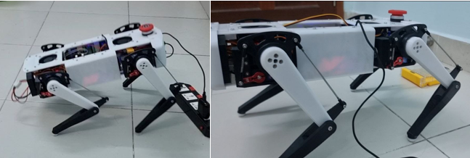

7. Results
7.1 Standing test
Standing still for $15 mins$
Figure 7.1 The robot after powered up and standing still

Slide 35
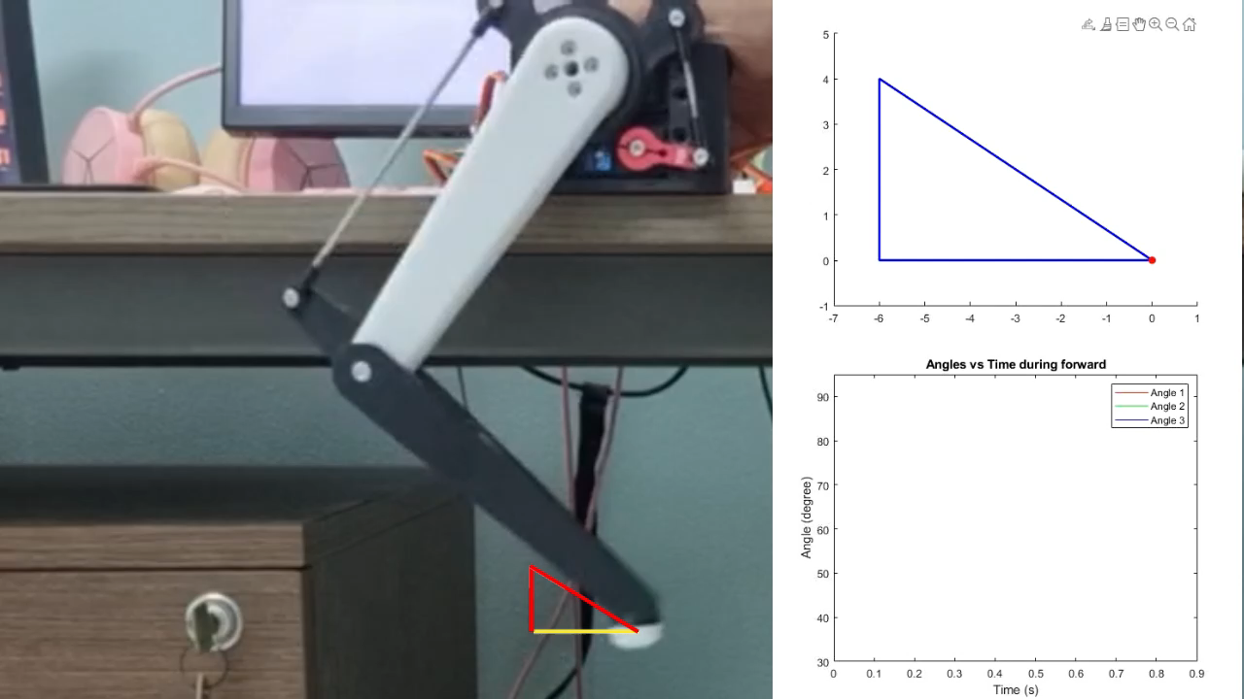
7. Results
7.2 Motion test

Slide 36
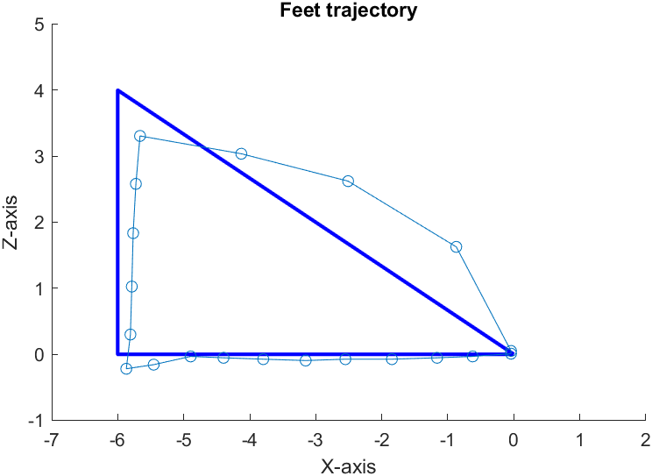

7. Results
7.2 Motion test
The robot can travel the distance of $2m$ in 9.24 seconds, equating to an average velocity of $0.21m/s$.
Figure 7.2 Feet trajectory during one step cycle
Notes:
Infrared sensor for timing and calculate avg velocity

Slide 37
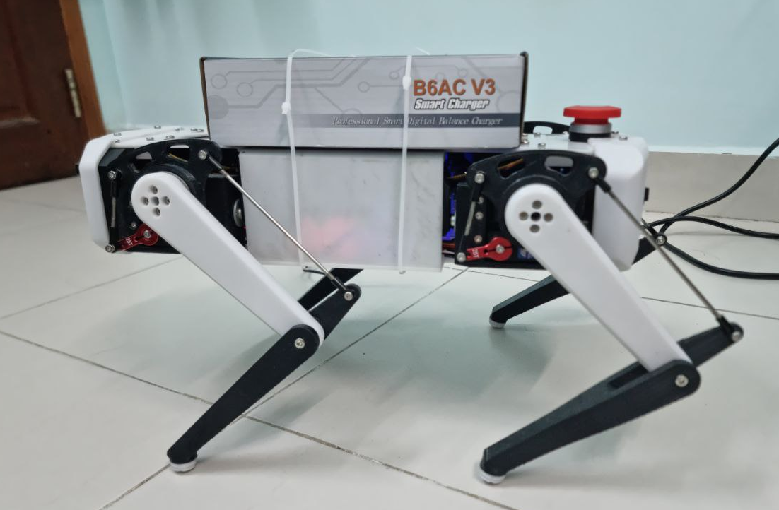
7. Results
7.3 Payload test
Figure 7.3 500g payload test on the assembled robot
Notes:
Fail: Over-current, add another buck converter to distribute current load. Nomial 1.4A, Max 3.5A

Slide 38
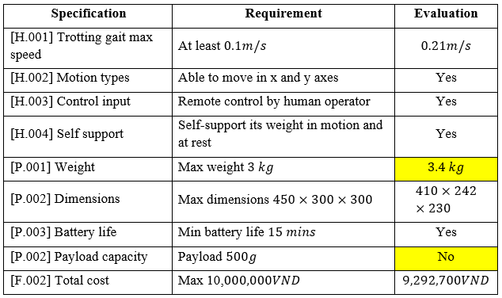
8. Conclusion
8.1 Accomplishments
The robot successfully met 7 out of 9 requirements

Slide 39
8. Conclusion
8.2 Future work
Design a suitable driver board for better current load distribution.
Improving gait of the robot for rough terrain, including:
IMU integration with PID control for balancing
Leg position encoders for closed loop control
Sensors at the feet for contact detection
Adding camera and LIDAR to enable research in area such as:
Location mapping algorithms
Image recognition

Slide 40
References
[1] Gonzalez-de-Santos, Pablo & Garcia, Elena & Estremera, Joaquin. (2006). Quadrupedal locomotion. An introduction to the control of four-legged robots. Quadrupedal Locomotion: An Introduction to the Control of Four-legged Robots. 10.1007/1-84628-307-8.
[2] Zhong, Yuhai, Runxiao Wang, Huashan Feng and Yasheng Chen. “Analysis and research of quadruped robot’s legs: A comprehensive review.” International Journal of Advanced Robotic Systems 16 (2019).
[3] https://pupper.readthedocs.io/en/latest/reference/controller.html

Slide 41
THANK YOU!

